Slide 1

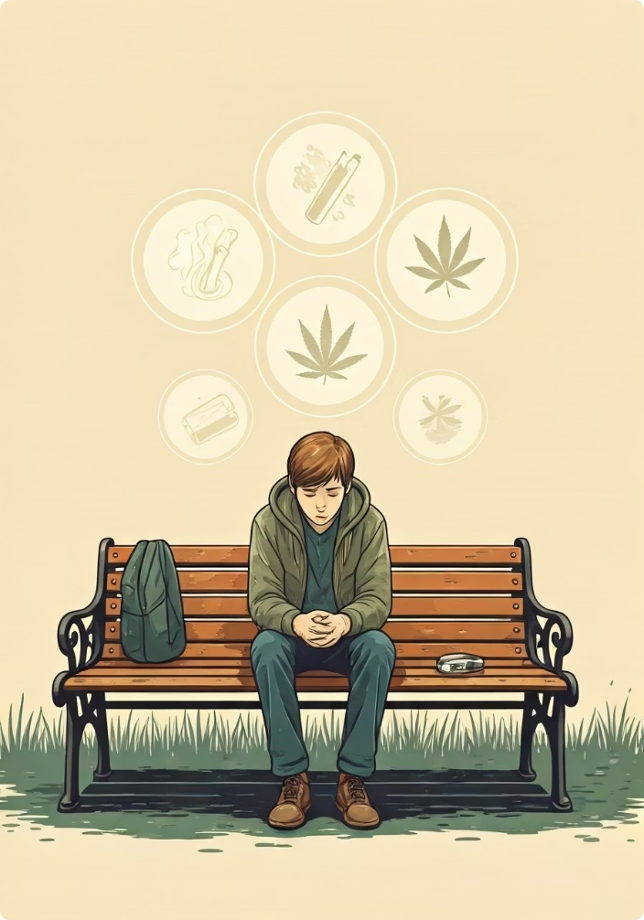

Predicting Youth Substance Use: A Decision Tree Approach
Insights from NSDUH Dataset on Cigarette and Marijuana Use
by Mohammed Khaja Moinuddin

Slide 2

Introduction
1
Binary Classification
2
Multi-Class Classification
Predict cigarette use initiation
Categorize marijuana use frequency
3
Regression
Estimate age of first cigarette use
Dataset: NSDUH with substance use, demographic, and social variables

Slide 3
Theoretical Background
Decision Trees
SMOTE
Classification vs. Regression
Recursive partitioning based on thresholds
Addresses class imbalance
Categories vs. continuous values
Synthesizes minority class samples
Tuning: max_depth, min_samples_leaf
Limitations: Overfitting, instability

Slide 4





Methodology
Data Cleaning
Handled special codes, imputed missing values
Feature Engineering
Created interaction terms for school and parents
Model Implementation
Tuned hyperparameters via cross-validation
Evaluation
Classification: Accuracy, Precision, Recall, F1

Slide 5
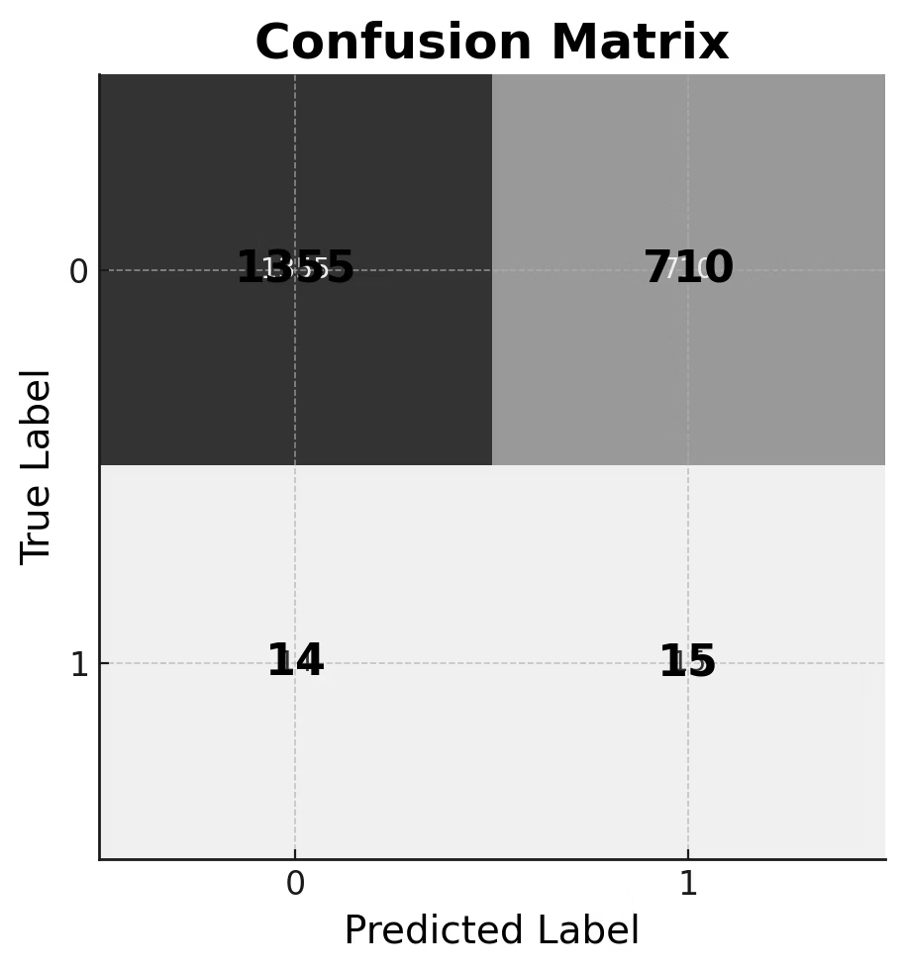
Binary Classification Results
65%
52%
Accuracy
Recall
"Ever Used" class
2%
Precision
"Ever Used" class
Key insight: Parental help and school safety drive predictions

Slide 6

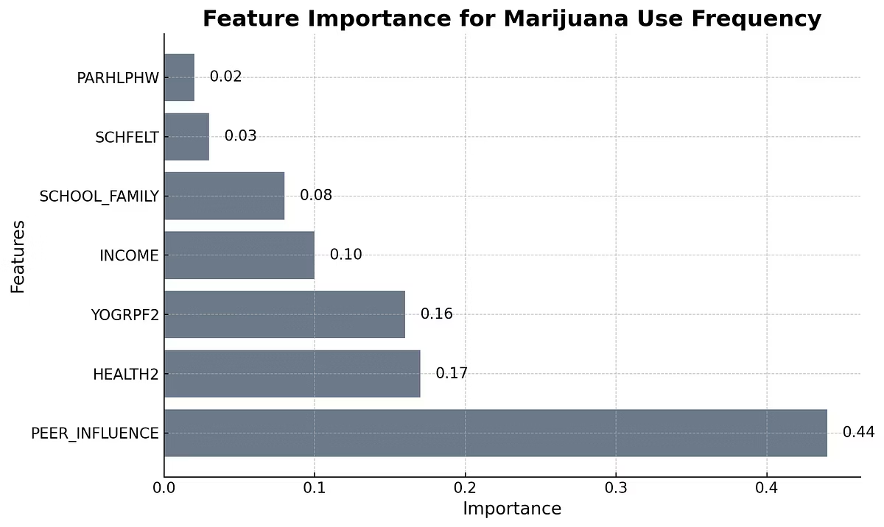
Multi-Class Classification Results
Accuracy: 75%
Precision: 17%
"Seldom" class
Recall: 53%
"Seldom" class
Key Insight
Peer influence explains 43.9% of feature importance

Slide 7
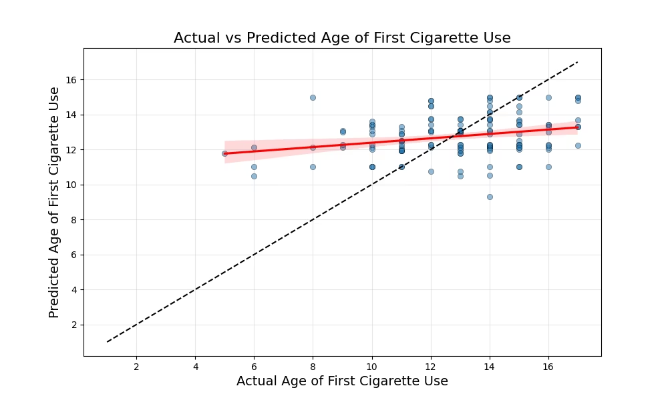



Regression Results
MSE: 5.8579
RMSE: 2.4203
R²: 0.0328
Key insight: Income is strongest predictor of earlier initiation age

Slide 8
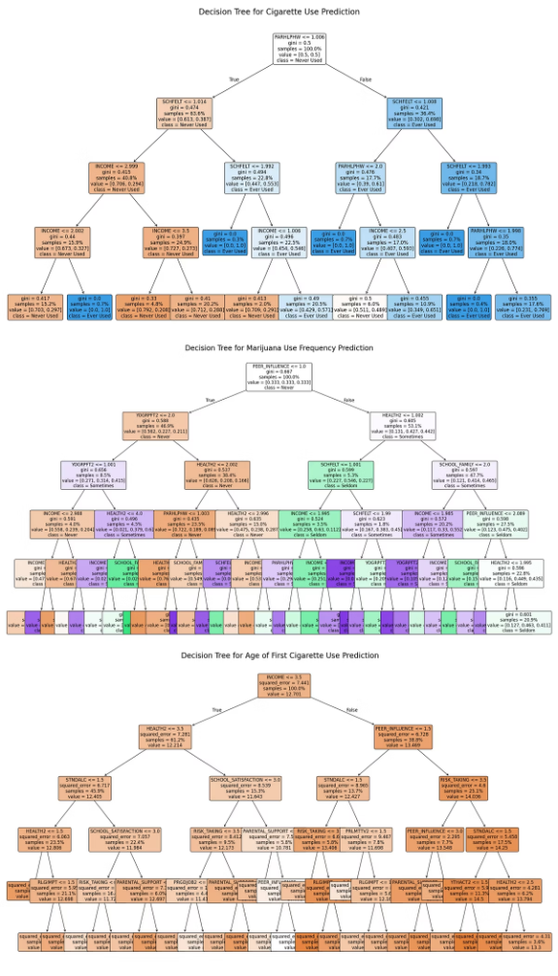
Model Comparison
Model
Accuracy/MSE
Key Predictors
Depth
Binary
65%
Parental Help, School Safety
4
Multi-Class
75%
Peer Influence, Health
5
Regression
MSE=5.86
Income, Peer Influence
5

Slide 9








Discussion
Performance
Interpretation
Good accuracy, low precision for minority classes
Parental support and school safety are key levers
Improvements
Limitations
Ensemble methods, additional predictors
Self-reported data, limited features

Slide 10



Conclusions
Policy Impact
Target parental support in low-income schools
Public Health
Design peer resistance training
Future Work
Expand to vaping/opioid prediction

Slide 11

Thank You
Thank you for your time and attention. I hope this analysis was insightful.

